Slide 1
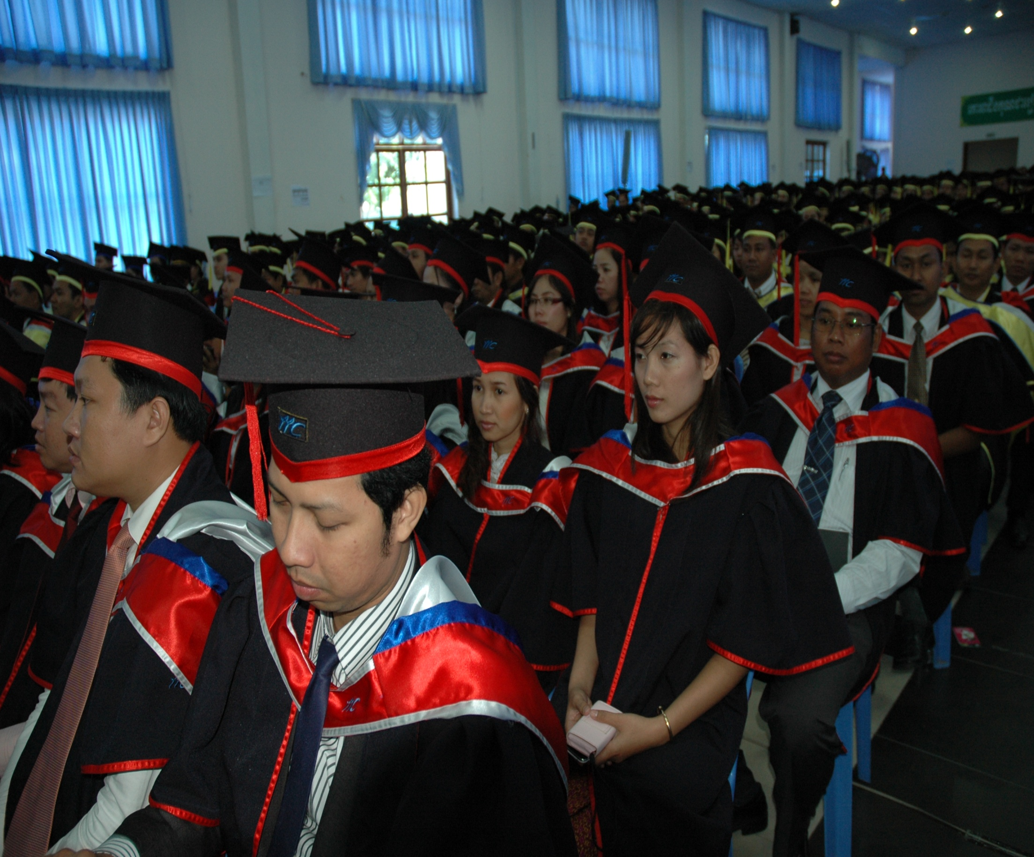
Postgraduate School IIC University of Technology The Kingdom of Cambodia Nurturing Industrial Leader
Starting Guide for Industrial Ph.D

Slide 2
VISION & MISSION
VISION
To nurture industry leader with high problem solving skills
and strong fundamental of body of knowledge.
MISSION
To create a human potential with high creativity and innovation in problem solving to increase the organization productivity.

Slide 3
Industrial Ph.D
A qualification to train professionals to solve industrial oriented problems.
The qualification is designed for the industrial professionals who have interest to contribute to the field of industry (content) and body of knowledge.

Slide 4
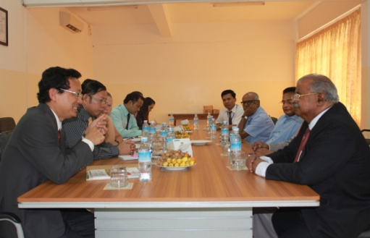
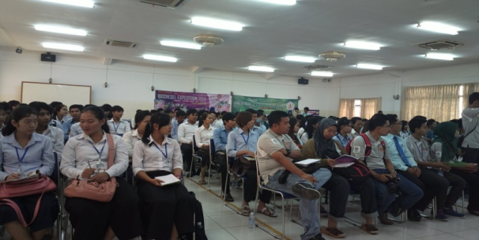
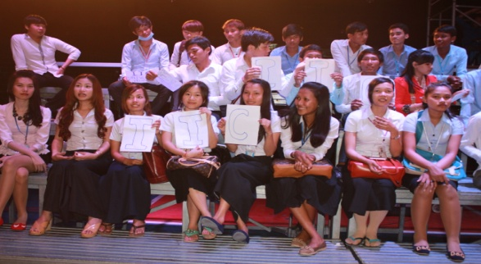
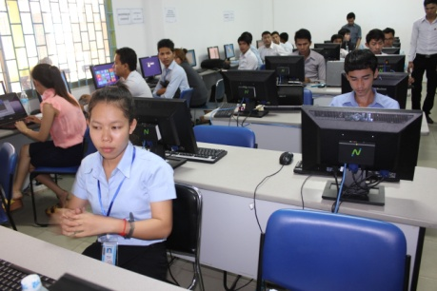
For Whom?
This program is designed for professionals who have with a minimum of 5 years working experience and contributed their experiences to solve industrial problems.
The program helps the professionals to conceptualize their thought and thinking in strategic ways to solve industrial problems.

Slide 5
So What about the Program
Solve industrial problems
This program helps the top management to evaluate and plan strategically to solve industrial problems.
Organization branding
To share the achievement accomplished by the company.
Create a knowledge sharing society for other industries.
Company breaches a link between academic perspective and industrial perspectives.
Academic perspective focuses on the model development.
Industrial perspective focuses on the practicability of the model development.
Notes:
5

Slide 6
Traditional PhD vs Industrial Ph.D
Traditional PhD
Industrial Ph.D
Industrial doctorate.
Research focus on new practices current issues faced by the industry.
Dissertation by portfolio.
Coaching methodology.
Research thesis for contribution to new body of knowledge.
Thesis (100% by research)
Certain number of courses.
Academic doctorate.

Slide 7
Industrial Ph.D at IIC
A program trains researchers conceptually and practically to solve industrial problems.
By the end of the program, researchers would contribute to both the body of knowledge and also industrial practicability.

Slide 8
What are the Value Proposition for IIC’s Industrial Ph.D?
Internationally
Not many universities appreciate working experience as entry requirement in Ph.D Program. IIC offers a conversion and promotion from degree to Ph.D when they reach the requirement.
Collaboration between practitioners and academic expertise in industry problem solving industrial problem.
Collaboration between industrial expertise and academia in solving industrial problems.
Most universities offer Industrial Doctorate only for Technological related field. IIC opens this opportunity to all body of knowledge.

Slide 9
Why IIC Industrial Ph.D?
Understand
We The Industrial Needs
And
The of The Researcher
MORE SIGNIFICANTLY
NEEDS

Slide 10
IIC University of Technology
We serve you Differently

Slide 11
Insufficient Guidance.
Every time when candidates meet their supervisors, the supervisors would ask them to read more journals. In reality, candidates do not know what is needed from the journals!
IIC Supervisory: Complete Guidance
All supervisors at IIC University provide complete guidance to the researchers. They would meet the requirement and expectation of the write up. For example, in background of the study (Chapter One), researchers would be guided with a series of questions to help them to write this chapter. Supervisors would provide systematic ways to help candidates to learn thoroughly of an issue. In addition, all IIC supervisors will provide a few samples of write up for researchers to refer to the correct example. With the complete examples, researchers would enjoy the process of learning!

Slide 12
Insufficient Follow up.
Supervisors do not plan with the candidates the timeline of completion. Researchers are not motivated to complete their researches.
IIC Supervisory: Ample time of communication with the Supervisors
IIC University’s supervisors’ codes of ethics are to follow up with the candidates. It is essential to follow up with the researchers. In addition, researchers can communicate with their supervisors via various methods such as E-mail, Skype, Viber, Whatapps, Line, WeChat or Voodoo. With digitalization and globalization, the world has become borderless. Researchers can communicate with the supervisors at any place and any time at their convenience.

Slide 13
Ambiguous Instructions.
Supervisors give different instructions and guidance for the researchers when meeting them.
IIC Supervisory: Clear and Systematic Guidance
Supervisors would provide a checklist for your write up before you start your research. With the checklist, candidate would know what are the requirement and expectation to complete their research.

Slide 14
Supervisor Drop Out.
Some supervisors leave the university after a period of time or after their contract. As a result, researchers need to start all over for their research work after shifting to new supervisors.
IIC Supervisory: Committed Supervisors and Flexibility in Choosing Supervisors
All IIC University Supervisors are committed. The supervisors would undergo strict evaluation before being appointed as supervisors. The evaluation includes number of publications, their past experience of supervision and their field of studies. The supervisors would be motivated to work closely with the researchers to complete their studies. When supervisors drop out, IIC University would provide another supervisor without requesting you to start the research all over.

Slide 15
Conflict between Main and Co-supervisors
When argument happens between main supervisor and the co-supervisor, the demand, direction and request of the supervisors are different. Researchers are in huge dilemma.
IIC Supervisory: Sole Supervisor to avoid Conflict
You do not need a team of supervisors. IIC University believes in quality and not the quantity. Of course in research, it is advisable to seek advice from more professionals. However, all supervisors in IIC University are committed to help each other. Hence, candidates could get assistance from various sources when they are stuck in their research.

Slide 16
Dictatorial Supervisors
Supervisors who were assigned by the university are not the subject expert in the field that you would like to do. As a result, researcher is forced to change their research topic to suit the requirement of the supervisor.
IIC Supervisory: Trained and Empathy Supervisors
All IIC University Supervisors are trained to serve with heart and soul. IIC University supervisors were once PhD researchers. They understand the dilemma and pain faced by candidates during their studies. As a result, IIC University supervisors would listen to the needs of the researchers based on their interest and assist them to study in-depth.

Slide 17
Finished Research Grant
Some researchers were drag and cannot continue their research because the research grant depleted and researcher cannot continue to complete the research.
IIC Supervisory: Proper Planning Before Initiating Research
Supervisors would provide guidance and advice on all the research procedure to avoid any obstacles during research. Supervisors would help to foresee any hindrance when conducting a certain research. In addition, supervisors help to identify the contingency methods to enable researcher to finish their studies.

Slide 18
Improper Evaluation
The supervisor does not critically evaluate the paper when candidates submit their thesis write up to the supervisors. Candidates assume that their write up is up to standard and they are staying on the right path. Unfortunately, the candidates get rejected during Viva Voce because the external examiners found some major problems in the research and write up.
IIC Supervisory: Standard Evaluation
All supervisors are trained on standard of evaluation of each submission. Before submitting the final thesis, supervisors would get a second reviewer to ensure the thesis has reached doctorate level. With a clear standard of evaluation, researchers would know the area of evaluation and ways to improve their theses before submitting.

Slide 19
Long Waiting Time for Feedback and Evaluation
In some universities, candidates need to wait for months to get feedback from their supervisors. The delayed evaluation and feedback reduce the motivation of researcher.
IIC Supervisory: Fast Feedback and Evaluation Period
Supervisors would provide feedback to the researcher within 10 working days after the work is submitted for monthly work progress. However, if it involves several chapters, longer time might be needed. Please you are advised to maintain your communication with your supervisor to plan your schedule ahead.

Slide 20
Complex University Procedures
Some universities need the candidates to form a research committee in their research. In addition, any approval such as comprehensive examination, the proposal defence, candidates need to get all members in the committee to attend it together. It has always been a challenge for candidates to get their supervisors to sit together for any approval.
IIC Supervisory: Simple Procedure during Supervisory Process
Researchers can communicate with their supervisors through one to one coaching session. Once the supervisor agrees that the researcher is ready for proposal defense and Viva Voce, the researcher can proceed with the final examinations.

Slide 21
Learning Method

Slide 22
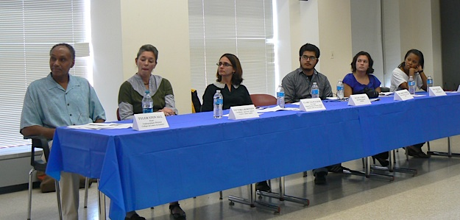
Learning Method
Library
One to One Coaching
Research Colloquium

Slide 23
Audit Subjects
IND 6006 Research Proposal Writing
IND 6016 Data Collection
IND 6026 Thesis Writing
IND 6036 VIVA VOCE Preparation

Slide 24
Admission Requirements
Entry qualifications for Industrial Ph.D
1. Possess a recognised Masters Degree in relevant fields OR
2. Other equivalent qualiﬁcations recognized by IIC Senate.
3. Professional with 5 years working experience with a minimum of degree.*
*Candidate would undergo 6 months of Master conversion program.

Slide 25
Duration

Slide 26
Full Time (3-6 Years)
0th – 10th month
25th Month - 36th Month
18th Month –
24th Month
11th – 18th month
Preparation of Proposal
Development of Tools/ Model
Data Analysis and Write up
Conclusion
VIVA Examination
Yea 2
Proposal Defense
Ethical Clearance
Improvement of
proposal

Slide 27
Part Time (4-8 Years)
Year One
Year Four
Year Three
Year Two
Preparation of Proposal
Development of Tools/ Model
Data Analysis and Write up
Conclusion
VIVA Examination
Yea 2
Proposal Defense
Ethical Clearance
Improvement of
proposal

Slide 28
Fees Structure

Slide 29
Pre-Enrolment
Application Fees |  | USD 50 ONLY
Registration Fees
Registration Fees |  | USD 100 ONLY
Tuition Fees
Masters Entry |  |  | USD 10 000/program*
Scholarship
Candidates can apply for scholarship to fund their studies. The application is subjected to the university approval.
Note | * Researchers can pay the fees in instalment mode. Deferments of studies DO NOT affect the program fees. * Program fees do not include VOCE VIVA Fees and Doctorate Convocation.

Slide 30
How to apply?
Application
Visit to IIC University of Technology website at www.iic.edu.kh
Download the Application Guidelines/
Click “Application Form” and “Application Referee”
Complete and email to info@iic.edu.kh or graduate
Required Documents
1 Certified true copy of Identity Card/Passport (A4 size)
2 copies of recent passport-sized colour photograph with name written on reverse
Certified true copies of the relevant degrees and academic transcripts
(if certificates / academic record are in language other than English, it must be accompanied with
approved translation)
Certified true copies of TOEFL, IELTS or intensive English programme certificate (if any)
1 copy of Curriculum Vitae (CV)
Note: Certified true copies for all the required documents
Intent of Research
Kindly courier the required documents to:
Building No. 650,
National Road 2,
Sangkat Chak Angre Krom.
Khan Mean Chey
Phnom Penh, Cambodia
Notes:
How to download. Cant understand Cambodia language

Slide 31
How to Register?
Campus Registration
Visit IIC University of Technology, The Kingdom of Cambodia.
Print the Offer Letter.
Make the registration at Financial Department.
Once registered, the candidate will be entitled to the following:
Student ID card (issued by Registry office).
Student Handbook (available at www.iic.edu.kh)
Guidelines for Proposal Writing .

Slide 32
Stages of Research
Stage 1
1.1 Appointment of Supervisor
1.2 Preparation of Research Proposal
1.3 Proposal Defense
Stage 2
2.1 Research / Data Collection
Stage 3
3.1 Thesis / Dissertation report writing
Stage 4
4.1 Thesis / Dissertation Submission
4.2 Nomination and Appointment of Thesis/Dissertation Examiners
4.3 Recommendation of Thesis/Dissertation Evaluation by Supervisor & Examiners
4.4 Thesis/Dissertation Examination / Viva voce
4.5 Graduation

Slide 34
1.1 Appointment of Supervisor
The candidate can assign their own supervisor by completing the form APP005 Nomination of Supervisor , send the proposed Supervisor’s full CV (latest) to Postgraduate School (PGS) at info@iic.edu.kh
Then, PGS will propose to the Academic Studies Committee (ASC) and University Senate meetings for approval (normal duration is 10 working day).
PGS will send the official appointment letter to students & supervisors via email once Senate has approved the appointments.

Slide 35
Progress Monitoring
Students are requested to discuss their research progress with their Supervisors and submit a half-yearly Progress Report (Form AAP 010 Progress Report) by the first week of January and the first week of July to PGS at info@iic.edu.kh
The supervisor shall grade the progress of the student either Satisfactory (S) or Unsatisfactory (U).
A student who has obtained grade “U” (Unsatisfactory) for 3 consecutive semesters will be referred to the Academic Advisor.

Slide 36
1.2 Preparation of a Research Proposal
To complete research proposal, candidate can refer to
Guidelines for Research Proposal
Upon recommendation from the supervisor , the student should complete the fill research proposal and submit the Form APP 012 Submission of Thesis Proposal. Research proposal and power point slides need to be sent to PGS at info@iic.edu.kh
The proposal defense shall normally be conducted within 2 months.

Slide 37
1.3 Proposal Defense
Dean of PGS with recommendation from Head of respective school and supervisor to nominate members of Proposal Defense Committee:
1 Chairman
2 Readers
PGS to propose the appointment reviewers for approval.
PGS to send official appointment letters, research proposal, power point slides & Form PGS 005 Report of Proposal Defense by Reader to proposal defense committee via email.

Slide 38
1.3 Proposal Defense
PGS to conduct the Proposal Defense Session.
Student will be given 20 minutes to present the proposal to the committee.
Proposal Defense Committee evaluates the proposal via:
Form PGS 006 Recommendation from Proposal Defense Committee
Student can embark on the research once approved by the proposal defense committee.
A student shall be given 3 opportunities to pass the research proposal. Failure on the third attempt shall result on the termination of his / her candidature.

Slide 40
2.1 Research / Data Collection
6. Data collection
The supervisor shall assist and supervise the student in the preparation of the thesis/dissertation and to ensure that the thesis/dissertation meets required standards.
Should you need an authorization letter to conduct research, please complete the form and send to info@iic.edu.kh

Slide 42
3.1 Thesis / Dissertation Writing
Candidate should refer to APP013 Guidelines for Dissertation Writing to complete your dissertation write up.
The required specification is described in the guidelines, APP013

Slide 44
4.1 Thesis / Dissertation Submission
Notice of Submission of Dissertation/Thesis
A student is required to give 1 month notice to PGS of his intention to submit the thesis/dissertation by submitting Form APP 0014 Notice of Submission of Thesis Dissertation, Table of Contents (TOC) and Abstract of the dissertation/thesis to info@iic.edu.kh
Submission for Checking of Format
An unbound copy of the thesis/dissertation shall be submitted to PGS to be checked for conformity to the format requirements.
Thesis/Dissertation Submission for Examination
5 soft bound copies of the completed dissertation and power point slides must be submitted to the PGS. Complete the form APP015 Submission of thesis for examination when the dissertation is readied for submission.

Slide 45
4.2 Nomination and Appointment of Thesis/Dissertation Examiner
Head of PGS with recommendation from Head of respective School & Supervisor to nominate the examination committee.
The supervisor would complete the form APP020 nomination of examiners.
The Examination Committee shall comprise of:
Dean or his representative as Chairman
1 Internal examiner and
2 External examiners
PGS to propose the appointment of the examiners to senate for approval.

Slide 46
4.3 Recommendation of Thesis/Dissertation Evaluation by Supervisor & Examiners
PGS sends the official appointment letters, thesis (soft bound copies), Guidelines for Examiners & Form EXA 005 Recommendation of Thesis Dissertation Evaluation by Supervisor & Examiners to the examiners once Senate has approved the appointments.
The supervisor & examiners are given 2 months to examine the thesis/dissertation.

Slide 47
4.4 Thesis Examination / Viva Voce
PGS conducts Viva Voce after receiving the reports of thesis/dissertation from the Supervisor and Examiners.
The university shall invite the Supervisor to attend the Viva Voce but his/her presence is not mandatory. The Supervisor’s role is to provide the examiners with any assistance they require but will not take an active part in the viva voce.
Student will be given 30 - 60 minutes to present to the Examination Committee.
Following the Viva Voce a joint report should be prepared and agreed by the examiners and submitted by the Chairman of the Examination Committee to the School.

Slide 48
4.4 Thesis Examination / Viva Voce
The recommendation from the Examination Committee shall be one of the following:
(a) Thesis/Dissertation is accepted
(b) Thesis/Dissertation is accepted subject to:
(i) Minor modifications being made
Such minor modifications might include errors in grammar and/or syntax and/or minor changes in phraseology and/or
other amendments which do not significantly affect the conclusion of the dissertation/thesis.
(ii) Major modifications being made
Such major modifications might include serious omissions of sections and/or
inadequate argument in terms of the research questions/hypotheses and/or lack of adequate explanations of key concepts and principles.

Slide 49
4.4 Thesis Examination / Viva Voce…Cont
(c) Thesis/Dissertation requiring re-submission
This recommendation is used where substantial modifications (e.g. re-writing of sections or/and further experiments or/and profound correction of a scientific argument) are required to make the thesis/dissertation acceptable.
The thesis/dissertation following revision would normally be considered again by all members of the examination committee for final approval. A student will normally only be permitted to revise and re-submit a dissertation/thesis once.
Notes:
…Cont Apply or not to apply

Slide 50
4.4 Thesis Examination / Viva Voce
(d) Thesis/Dissertation is rejected with no right of revision or re-submission.
(e) If the thesis does not meet the requirements for the doctoral degree but does have merits which meet the requirements for the Master’s degree, the student shall be given the opportunity to submit the thesis in revised form for the appropriate Master’s degree.

Slide 51
4.4 Thesis Examination / Viva Voce…Cont
Final Submission of the Dissertation/Thesis
A student whose thesis/dissertation is accepted or accepted with minor or major modifications will have to submit to the school 5 hardbound copies of the thesis/dissertation (duly verified and corrected) together with a compact disc (CD) containing a soft copy of the thesis/dissertation within the prescribed time. The supervisor will be responsible to verify that all the required amendments have been made in the dissertation/thesis.
A student may, if necessary, apply to the head for extension of time for the final submission of his dissertation thesis. All such applications must be made through the supervisor. The head may, at his discretion, extend the time for final submission of a thesis/dissertation for up to 60 days but only one extension may be granted to a student. During the extension period, the student must continue to be a registered student.
If after being required by the examination committee, a thesis/dissertation is not amended and submitted by the student within the prescribed time, the thesis/dissertation shall be deemed to have been rejected by the examination committee.
Announcement of Examination Results
The examination results can only be released to the student concerned and to a party agreed to by the student
in writing.

Slide 52
4.5 Thesis Examination / Viva Voce…Cont
After final examination, candidate needs to submit APP016 Submission of Thesis Final Examination (VIVA).
After the examination board is approved, candidate need to submit the form APP018 Final Submission of Thesis.

Slide 53
4.6 Graduation
Award of Degree
The Senate shall confer a Master’s or Doctoral degree to a student upon recommendation by the University Examination Board once all the requirements for graduation have been fulfilled.
Graduation/Conferment Requirements
A student is eligible for conferral of a degree after fulfilling the following conditions:
Passed the Thesis/Dissertation Examination
Passed the Viva Voce Examination
Has paid all the due fees
Has fulfilled other requirements as specified by the university

Slide 54
Industry Ph.D
Dissertation

Slide 55
Chapter One : Introduction
1.1 Background of the study
To describe the current business /industry environment.
1.2 Problem Statement
From the background, identify all the possible problems.
1.3 Needs of study
From the problems, identify one of the most significant problem needs solution urgently.
1.4 Objective / Purpose of the Study
From the needs of study, objective of research is formed to help you to solve the problem.

Slide 56
Chapter One : Introduction
1.5 Research Questions
From the objectives, state all curiosities that derive from the objectives.
1.6 Hypothesis
Based on literature, create assumption for the study.
1.7 Definition of Terms
Provide meaning of terms used in the research based the research construct.
1.8 Significance of Study
Identify parties that would get benefit of this research.

Slide 57
Chapter Two: Literature Review
Provide practitioners to understand in-depth of the issues and all possible methods for problem solving.
At the end of the chapter, a theoretical framework is proposed to solve the problems.

Slide 58
Chapter Two: Literature Review
2.1 Background of the research
Provide details to explain and support what was discussed in 1.1 (Background); 1.2 (Problem statement) and 1.3 (needs of study).
2.2 Historical Background
Researcher needs to provide details development of the field of study. All methods of problem solving are discussed here.

Slide 59
Chapter Two: Literature Review
Theoretical Background
Build up a model to solve the problems.
Related Research
Other research that might discuss the issues and any problem solving methods.

Slide 60
Chapter Three: Research Methodology
Researcher needs to identify how they run the research.
The questions to be answered:
Who to test?
Where to test?
How to test?
When to test?
What to test ?

Slide 61
Chapter Four: Results
Observation and what they have encountered (Successful and Not Successful) when running the method propose to solve the problem.
Barrier/problems when running the method proposed.
What to do to improve the method during the process.
Final model that could be proposed after all the challenges.

Slide 62
Chapter Five:Results & Recommendation
Researcher needs to
conclude the proposed method.
Identify the implication for other practitioners.
suggest for other researcher how to improve it.
Identify the limitation in the research.

Slide 63
Wishing you all the best!

